Slide 1
WAVES – Science Overdrive
Laura Akesson, Thomas Gallo & Michael Fetsko
August, 2012

Slide 2
What to expect:
Back&Forth (Simple Harmonic) Motion
Pendulums
Resonance
Vibration and Sound
Waves / definitions
Pulses, Periodic waves, Standing Waves
Waves Math
Wave Interference and Light

Slide 3
Examples of Waves

Slide 4
Examples of Waves

Slide 5
Examples of Waves
So anyway…
What do all of these waves have in common?
Most importantly:
They go…
Up and down
Back a forth
Etc.

Slide 6
Back & Forth Motion
Pendulum clocks,
Masses on springs,
The motion of waves…
they all move back and forth!

Slide 7
Simple Harmonic Motion
When things move back and forth under certain conditions, we say that they exhibit Simple Harmonic Motion.
If an object is pulled away
from a center (equilibrium)
point, a force will pull that
object back to the center.
The farther an object gets
from equilibrium, the
more force pulls it back.

Slide 8
Activity Time: Pendulums
Given the following materials:
Washers, String, Paper clips, Meter sticks, Protractors, Timers
Can you figure out the only variable that affects the time it takes for a pendulum to swing back and forth?
Great for guided inquiry:
As a class, discuss what characteristics can be changed about the pendulum; have different groups test different independent variables.
Notes:
Pendulum Activity write-up Distribution

Slide 9
The Period of a Simple Pendulum
The period of a simple pendulum moving with simple harmonic motion can be determined using the following equation:
This is for small
amplitudes only (Θ«15°)
What is the only variable that affects the period of a simple pendulum?
Important: Amplitude does not affect this back and forth motion

Slide 10
Peter Parker Picks a Proper Period
By timing Peter Parker’s descent (t = T/4)…
Can you solve for the length of this pendulum?

Slide 11
Period and frequency
Cycle:
Any reoccurring action… for example……….
Period (T):
The amount of time it takes for a cycle to occur
Measured in seconds
Frequency (f):
The number of waves (or cycles) produced in a given amount of time
Measured in Hertz (Hz)

Slide 12
Period and Frequency
There’s a hint about the relationship between frequency and period hidden in their units:
Period: sec frequency: hz = 1/sec
They’re inverses! If you have one, you can simply solve for the other!

Slide 13
Center Stage
Count the number of revolutions she makes and divide by the time it takes her. This will give you her average period of revolution.
Solve for the frequency!

Slide 14
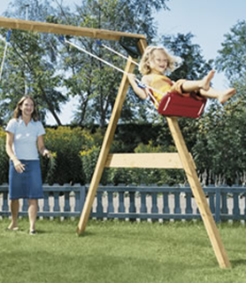
Forced Vibrations
Think of a child on a swing:
How do you keep her swinging?
Ah…so, if you match the frequency
of oscillation of the swing with a
periodic input of energy, the
amplitude will grow.
This type of motion is referred to as forced vibration.
- When the driving force equals the natural frequency of the system and maximum amplitude is reached, the system is said to be in resonance.

Slide 15
Cool Pool

Slide 16
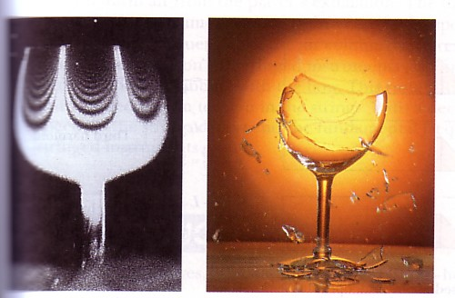
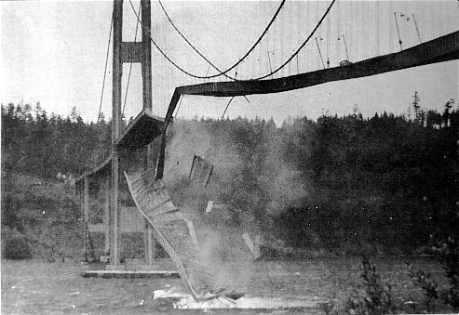
Examples of Resonance
Shattering goblets
Marching across
a bridge
Tacoma Narrows
Bridge Collapse

Slide 17
The Tacoma Narrows Bridge Resonance in Action

Slide 18
Demo: Resonance
If the tuning fork and the column of air have the same natural frequency, then the air will resonate and we’ll hear a loud sound.
There is an excellent “speed of sound” lab that you can do with this set-up as a culmination to this unit.
Details to follow.

Slide 19
Did you hear that vibration?

Slide 20
Sound
All sound comes from vibrating objects
The object vibrates the air (or other medium) near it, and the COMPRESSION wave travels from molecule to molecule.
It’s important to understand that sound doesn’t travel in a straight line.
Sound travels outward in all directions.
That’s why it can turn corners.

Slide 21
Sound from vibrating objects

Slide 22
Sound
There are three aspects of any sound:
A source – a vibrating object: voice, speaker, etc
A medium – solid, liquid, or gas
A receiver – an ear or microphone
So, what is wrong with this video clip?

Slide 23
Sound Properties
Pitch – How high or low
Comes from vibration frequency
High frequency = High pitch
Volume – How loud
Comes from vibration intensity (amplitude)
Big Amplitude = Loud Sound
(That’s why they call them… Amplifiers.)

Slide 24
Sound in Pipes
Time for another DEMO!
Please hold your applause until the end.
Activity: Sound in Pipes
This activity works for strings as well (Lab demo)
Important… what is vibrating?
The air or the water?
AIR! So, more water means less air, which means…
Less “stuff” vibrating, which means…
Faster vibration = Higher frequency and pitch!
Notes:
Demo: Sound in pipes
Activity: Sound in Pipes

Slide 25
Pendulum Waves
This “wave” motion is the result of multiple oscillators, each with a different frequency
How to make:
A meter stick, butterfly clips, washers, and string.
Notes:
Demo – Make a multiple oscillator pendulum

Slide 26
Multiple oscillators
Consider “the wave” at a sporting event.
Let’s try it!
What do you notice about the motion of each person? Which way do they move?

Slide 27
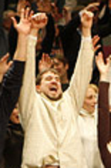
Wave definitions
Wave
A transfer of energy (not material) from one place to another
A distortion in a material
(Material moves only a little)
Medium
The material a wave
propagates (moves) through

Slide 28
Types of waves
Transverse
Medium moves at 90 degrees to the wave
Compression / Longitudinal
Medium moves in the same direction as the wave

Slide 29
Everyone Loves a Slinky!
Try making transverse and compression waves!

Slide 30
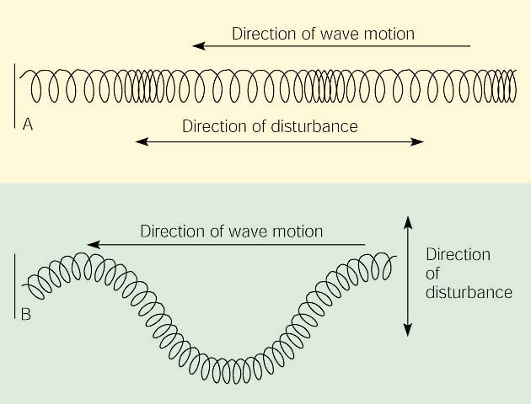
Review
Compression
Transverse

Slide 31
How many waves?
Pulse – like a stadium wave
One wave traveling through the medium
Periodic Wave – like an ocean wave
Waves the happen over and over
Standing Wave
Periodic waves that overlap
Appear to stand still

Slide 32
Wave Pulse
One wave travelling through a medium
Wave Vocab:
Amplitude: wave height
Velocity: wave speed = distance / time

Slide 33
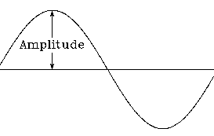
Amplitude
Amplitude
Maximum distance the wave vibrates from its rest position

Slide 34
Activity Time
As you work on the snakey activity, ask yourself the following questions:
What does affect a wave’s speed?
What does NOT affect a wave’s speed?
Notes:
Activity: Making Waves 1

Slide 35
Activity Follow-up
Does amplitude affect wave speed?
NO!
Only the properties of the medium affect the wave’s motion…
NOT whatever creates the wave…
how big a splash or a slinky-shake.

Slide 36
Periodic Waves
Periodic waves happen over and over
Ocean waves
etc.

Slide 37
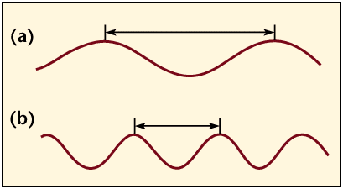
Wavelength
Wavelength (λ)
The distance from any point on one wave to that same point on the next wave
Crest to Crest
Trough to Trough
3 Nodes
(more on this later)
λ
λ

Slide 38
The wavelength of a longitudinal wave can be measured as the distance between the center of two compressions or rarefactions.
Wavelength
Note:
Compressions and Rarefactions are ANTI-nodes
“Normal” air pressure portions are the nodes

Slide 39
Wave Diagram
Let’s fill in what we know together.

Slide 40
Standing Waves
← Get it?

Slide 41
Modes
When periodic waves overlap we get a…
STANDING WAVE
On a string it looks like one of these modes:
Notice the number of waves on the string…
½ 1 1 ½ 2

Slide 42
Standing Waves

Slide 43
Ruben’s Tube: Coolest… standing wave… ever.

Slide 44
Standing Waves Activity
Let’s try an activity:
Let’s practice making standing waves…
Basically: match a standing wavelength with the frequency needed to create it.
Notes:
Activity: Making Waves 2

Slide 45
Practice – find A, λ, f, and v
12 m
10 cm
4 sec
A = 5 cm
λ = meters/cycles = 12m / 3 cycles = 4 m
f = cycles/second = 2 cycles / 4 seconds = 0.5 Hz
V = λf = (4 m)(0.5Hz) = 2 m/s

Slide 46
Speed of Sound Lab
Tuning fork shows frequency
Measure L and multiply by 4 and you have wavelength
Solve for velocity and compare to known value (340 m/s)
Physicslessons.com
Notes:
Speed of Sound Activity, Time permitting

Slide 47
Waves Vocab Review
Amplitude
Wave Height – does not affect wave speed
Velocity
Speed – faster in media that are more dense
Wavelength
Crest to crest, trough to trough, 3 nodes
Frequency
How often the waves occur, waves / seconds
Period
The time for one wave, seconds / wave

Slide 48
Wave interference
Crest + Crest = ?
Trough + Trough = ?
Crest + Trough = ?

Slide 49
Activity Time
Use a snakey to see constructive and destructive interference!
Notes:
Demo – Wave Interference

Slide 50
Double Slit Interference
When waves come from two sources they interfere and create this strange pattern
Easy to reproduce to a laser and apiece of paper
Light is a wave!
Notes:
Demo – Double Slit Interference

Slide 51
Light Interference NASA Classroom Activity
Easy interference demo / intro activity:
(Requires only black paper and microscope slides.)
Notes:
NASA Interference Patterns Activity

Slide 52
VA Physical Science Standards
PS.2c – States of matter
PS.6 – Transfer of energy
PS.8 – Sound waves
wavelength, frequency, speed, amplitude, rarefaction, and compression;
resonance;
the nature of compression waves; and
technological applications of sound.
PS.9 – Transverse Waves
wavelength, frequency, speed, amplitude, crest, and trough;
the wave behavior of light;

Slide 53
How to add video to your power point presentations…
Place a .wmv file somewhere you can find easily… desktop folder, C-drive
Under the “Home” menu
select a “layout”
that includes “content”
Select Insert Media Clip
on your slide.
Browse to the .wmv file.
Choose play options and resize, as needed.

